Slide 1

Student Management System • Developed in Java using NetBeans IDE
Team Members:
• - Mohammed Emad – ID: 246209
• - Shahd Walled – ID: 241823
• - Rabab Hamdy – ID: 248717
• - Abdul Rahman Atef – ID: 240064
• - Salma Hassan – ID: 243405

Slide 2
Presentation Topic
Student Management System

Slide 3
Introduction
• This project is a desktop-based Student
Management System built using Java SE and
NetBeans.
• The system is designed to manage student
information effectively.

Slide 4
Problem Statement
• Traditional methods of managing student
records are manual, time-consuming, and
error-prone.
• This project aims to digitalize and simplify the
management of student data.

Slide 5
Objectives
• - Automate student data management
• - Support CRUD operations
• - Enhance user experience
• - Improve data accuracy and se

Slide 6
System Architecture
• Three-Tier Architecture:
• - Presentation Layer: Java Swing
• - Logic Layer: Java Classes
• - Data Layer: MySQL Database

Slide 7
Tools & Technologies
• - Java SE
• - NetBeans IDE
• - MySQL Database
• - JDBC Library
• - Java Swing

Slide 8
Key Features
• - Add Student
• - Edit Student
• - Delete Student
• - View All Students
• - Search and Filter
• - Basic Form Validation

Slide 9
Database Design
• Main Table: students
• Fields: ID, Name, DOB, Email, Course
• Relationships: Optional tables for courses and
grades

Slide 10
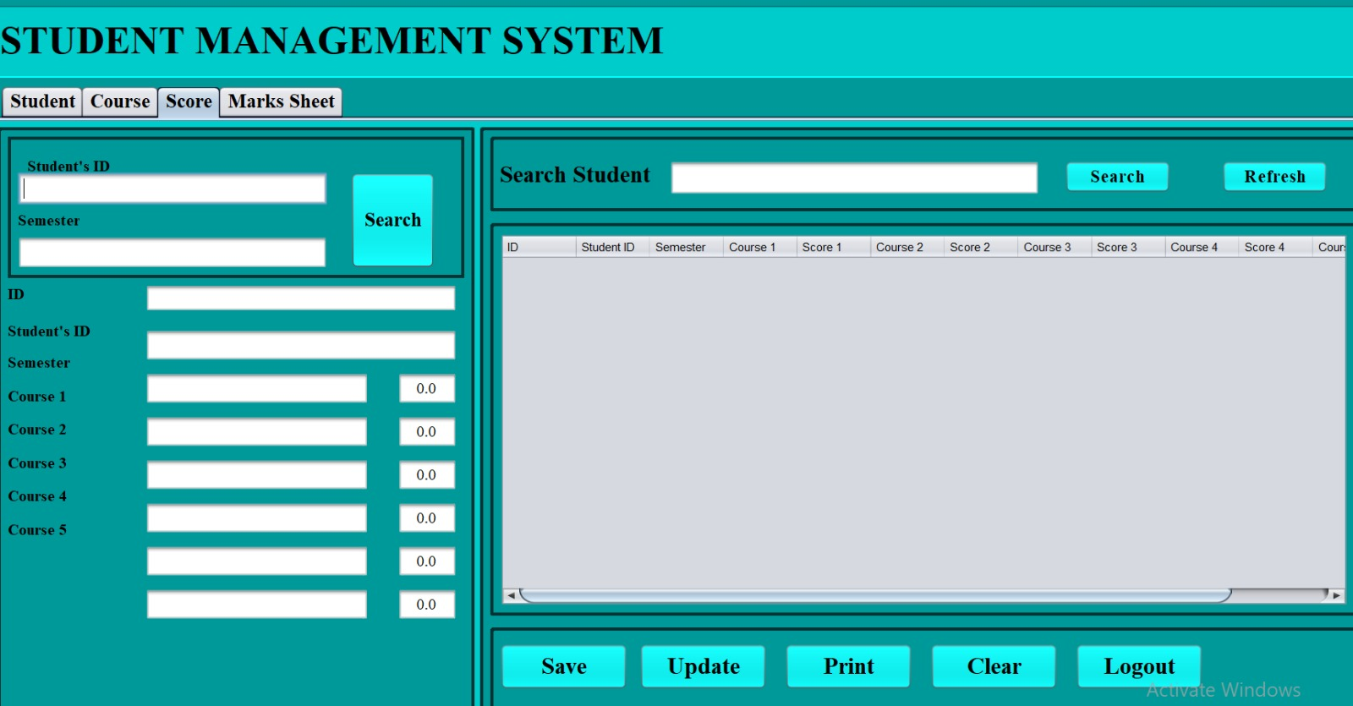
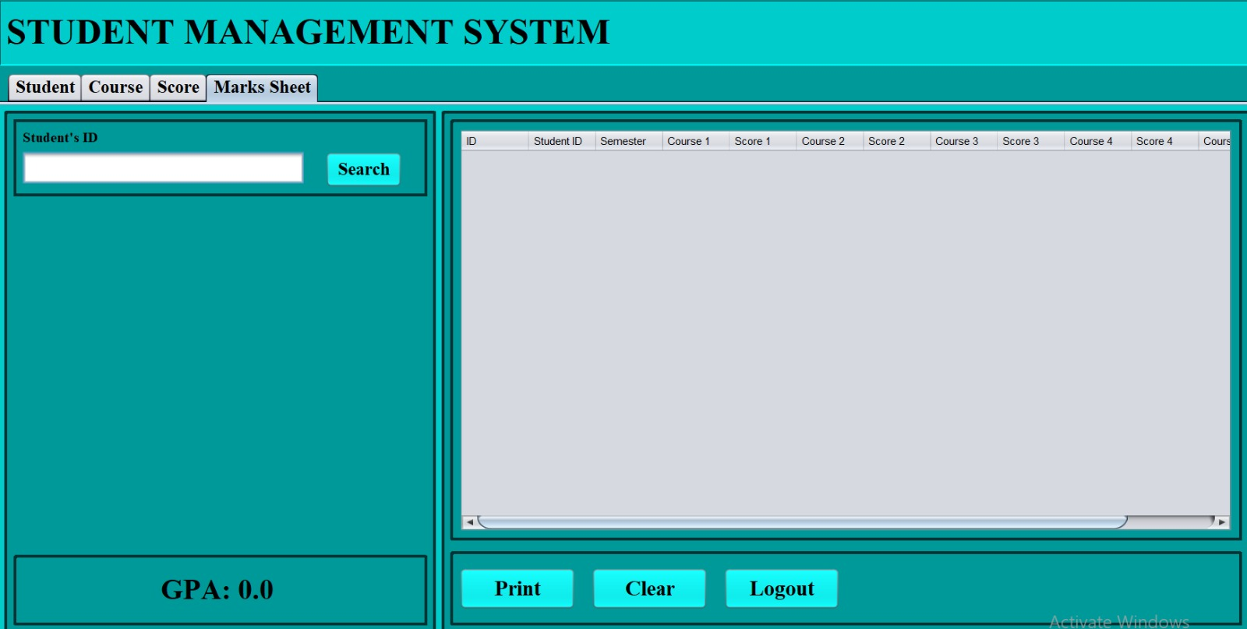
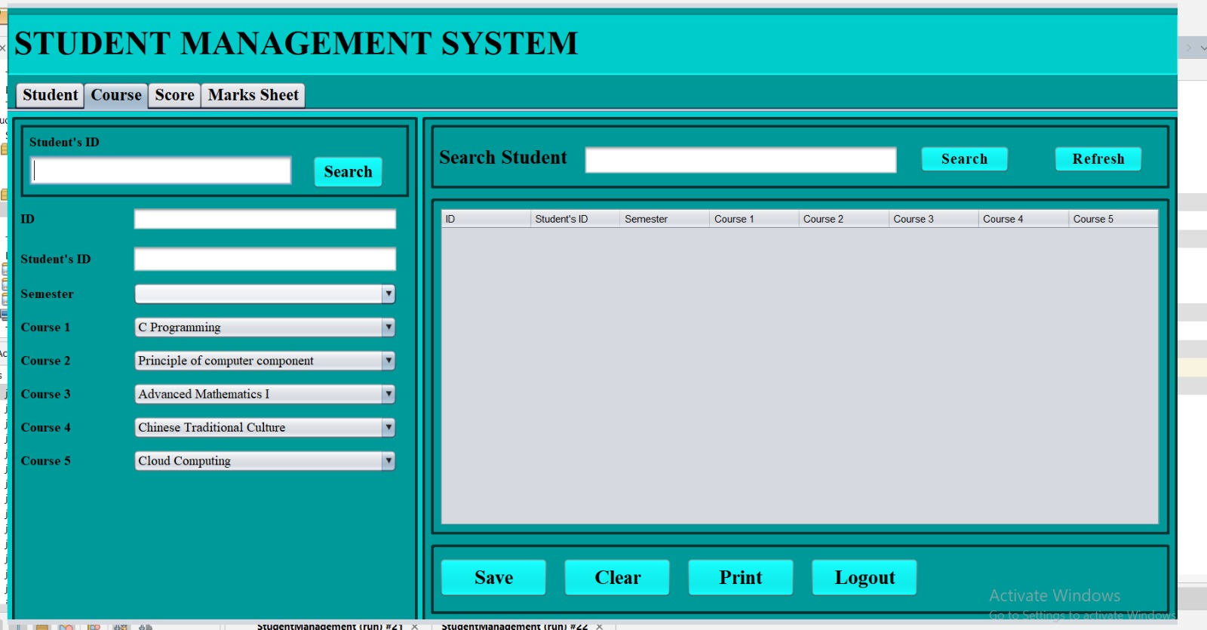
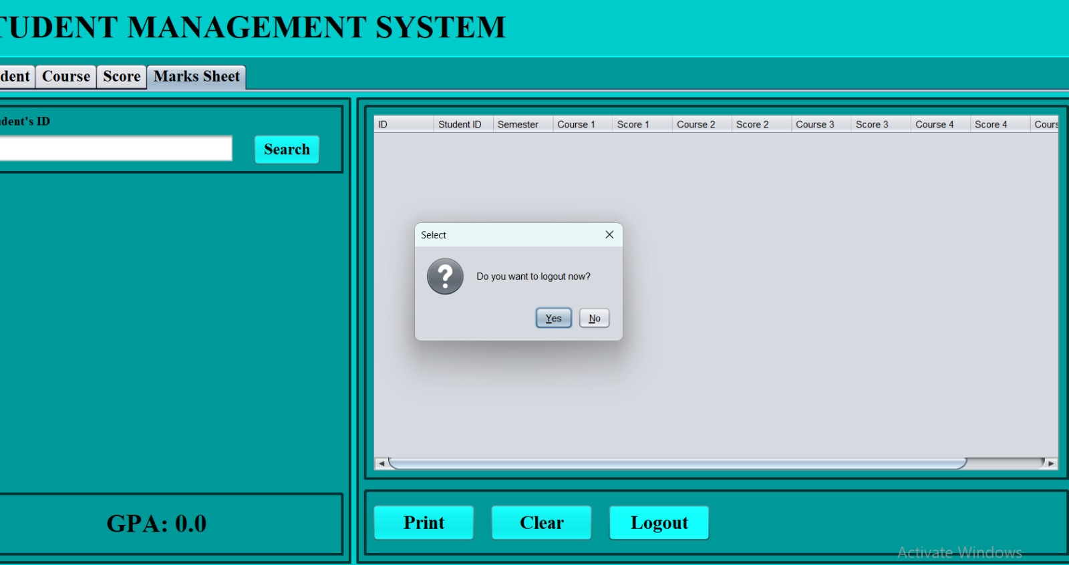

Slide 15
Faculty of NAME HERE

